Slide 1
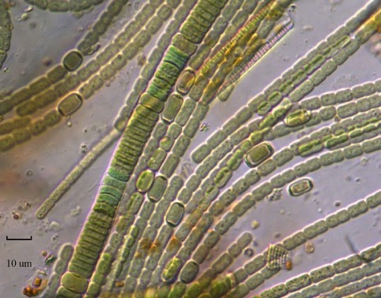
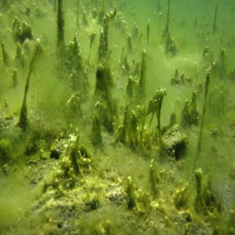
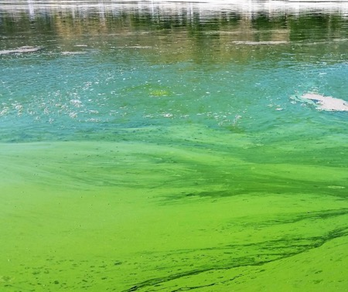
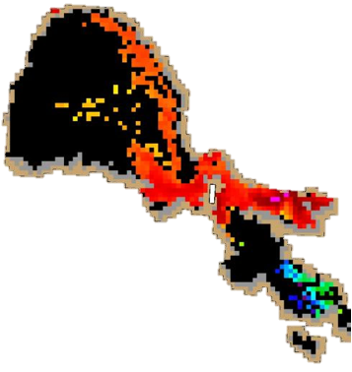
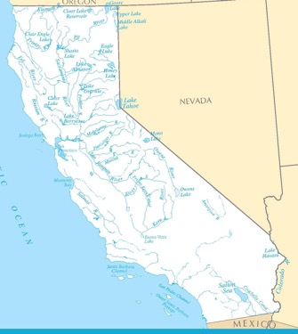
California Water Boards Freshwater harmful algal bloom monitoring strategy
Marisa Van Dyke & Keith Bouma-Gregson
Co-Leads Freshwater HABs Program
CCHAB meeting
April 12, 2019
Notes:
Good afternoon, everyone. My name is Keith Bouma-Gregson, I am an environmental scientist with the State Water Board and co-lead of the statewide freshwater harmful algal bloom program, or FHAB Program, along with Marisa Van Dyke.
Both Marisa and I work in the Office of Information Management and Analysis in the Surface Water Ambient Monitoring Program, or SWAMP.

Slide 2
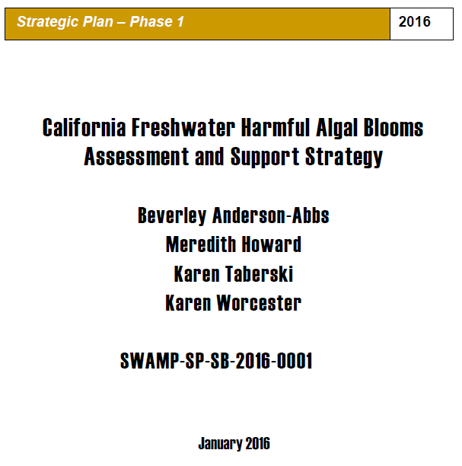
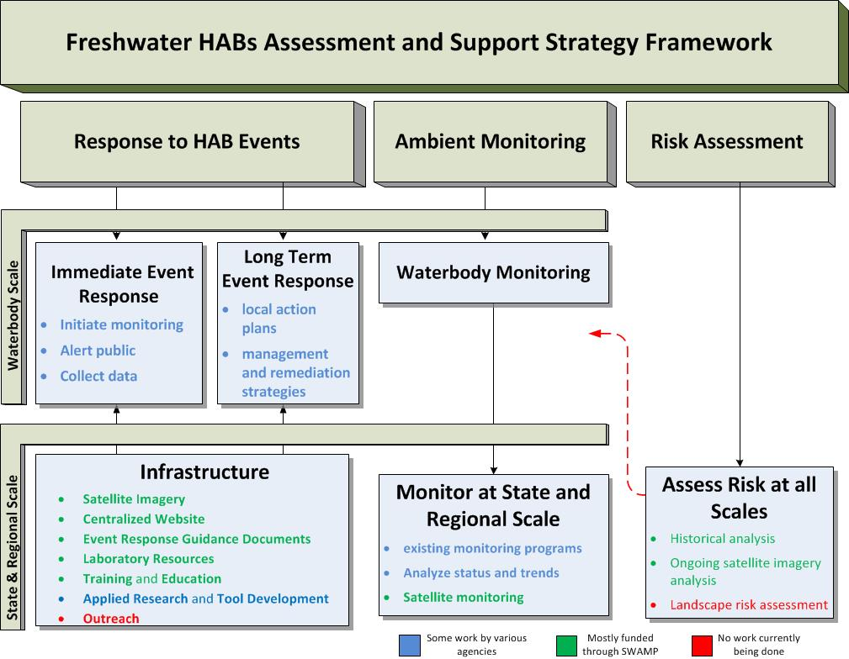
FHABs assessment and support strategy (2016)
Notes:
The focus is on recreational exposure and source water protection in waterbodies where recreational and drinking water uses overlap.
This is a summary figure from the 2016 assessment and support strategy. The strategy identified three large categories: response to hab events, ambient monitoring, and risk assessment. Since 2016 the state has been putting in place the infrastructure recommended to support responses to HAB events.
Since 2016, state resources have addressed event responses to blooms, and there are only a few regional or single water body monitoring programs active in the state. For example, the Klamath River and Clear Lake have bi-weekly monitoring throughout the summer carried out by Tribes in those watersheds.
I will now go over the event response infrastructure that has been created since 2016.

Slide 3
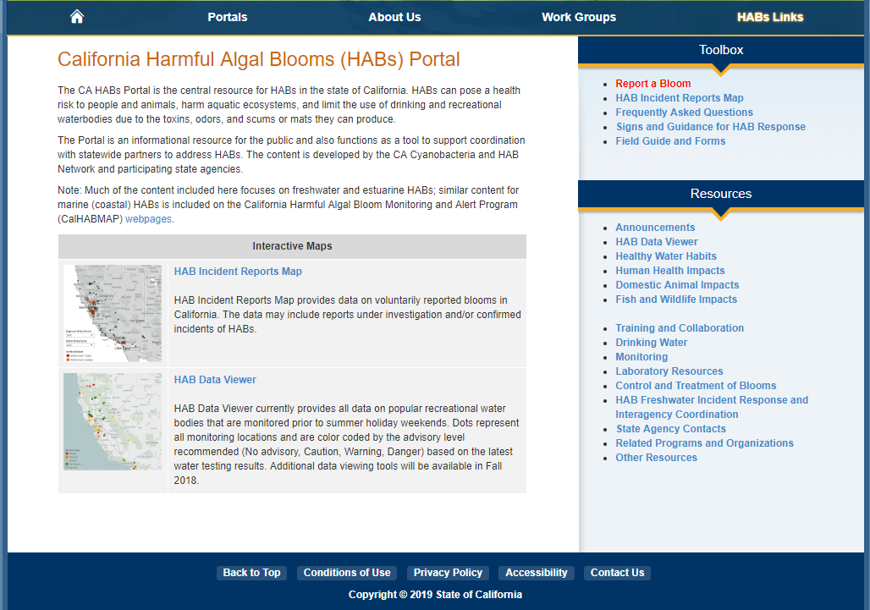
CA FHABs Portal
https://mywaterquality.ca.gov/habs/index.html
Notes:
We now have a centralized website and database for tracking HABs in California.
Red arrows highlight:
-report a bloom function VOLUNTARY REPORTS
-interactive maps with reports and event response data
-guidance for response
-resources on health impacts

Slide 4
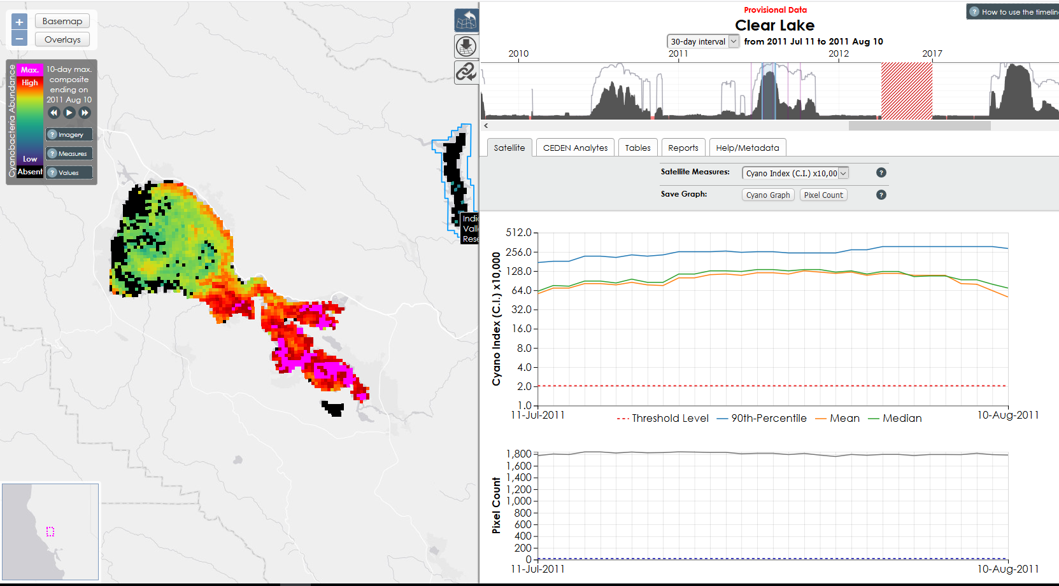
Satellite monitoring
Developed infrastructure for processing satellite imagery from NOAA
Track FHABs on ~250 waterbodies >~0.6 mi² area across the state
Created website for visualizing and downloading satellite data
Contracted with San Francisco Estuary Institute (SFEI)
Notes:
California has also been working with NOAA and to use satellite imagery for detecting HABs in lakes and reservoirs in the state. This image shows Clear Lake, and is a 10 day composite image from July 2011. The graphs on the right show sthe data in the image. The website allows you to visualize and download data for any lake on most any day extending back to 2002.
SFEI contract:
Develop infrastructure for processing satellite imagery
Historic Data
Analyze MERIS satellite data for 255 waterbodies (2002-2012)
Status and Trends report
Current Data
Analyze data from OLCI on Sentinel-3 satellite (launched Feb. 2016)
Reporting
Integrate with web portal for viewing imagery and related data
Inform state agencies and waterbody managers when bloom conditions occur
[Issue regular bulletins and newsletters to public] delete

Slide 5
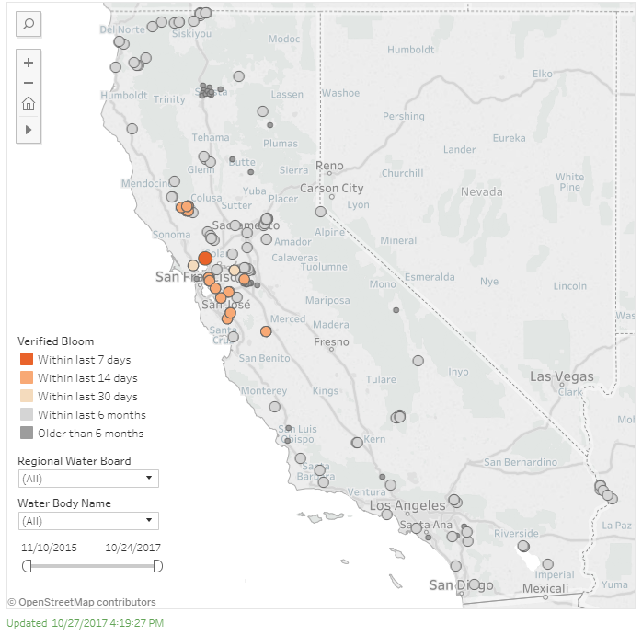
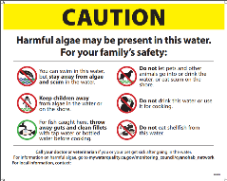
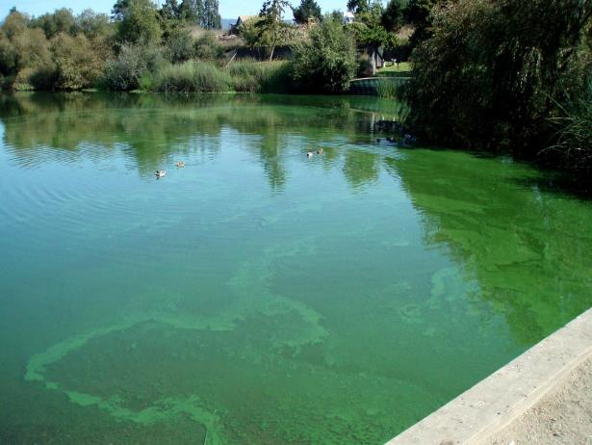
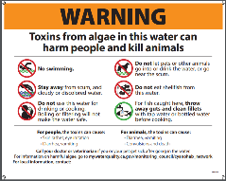
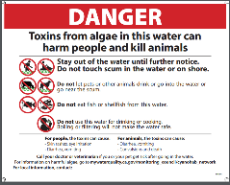
FHAB events in California
 | 2016 | 2017 | 2018
Total reports | 91 | 181 | 190
Total postings | 80 | 141 | 145
2018 advisory levels
92
53
Notes:
As a result of this infrastructure, we know more about the frequency and occurrences of HABs now than we did in the past. This table summarizes the voluntary reports submitted to the HABs portal over the last 3 years. Multiple reports sometimes lead to the same signage posting, which is why there are fewer postings than reports. The large increase from 2016-2017 is a result of more people being aware of the website and reporting blooms in 2017, compared to 2016, which was the first year of the program.

Slide 6
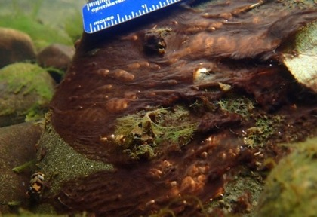
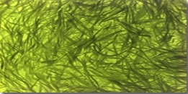
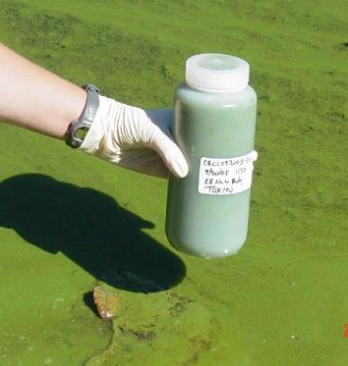
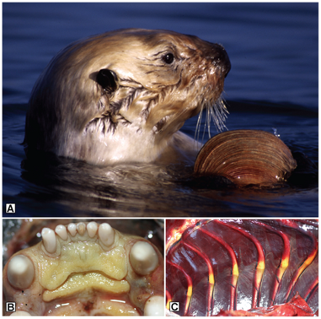
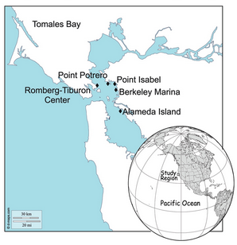
Diversity of FHABs in California
Waterbodies: rivers, lakes, reservoirs, estuaries
Environmental conditions: eutrophic, oligotrophic, low-elevation, high-elevation, saline
Photo: Keith Bouma-Gregson
Taxa: Microcystis, Dolichospermum, Aphanizominon, Cuspidothrix, Anabaena, Microcoleus, Nostoc, etc.
Cyanotoxins: Microcystins, Anatoxins, Saxitoxin, Nodularin, Cylindrospermopsin
Photo: klamathvalley.com
Photo: KarukTribe
Miller et al. 2010
Gibble and Kudela, 2016
Notes:
One of the take aways from the HABs data collected in the 21st century, is the diversity of blooms and environments that exist in California. We have blooms in a variety of waterbodies, environmental conditions, multiple taxa causing blooms, and multiple cyanotoxins detected. [and often co-occurring with other cyanotoxins] Addressing this diversity will be no dull task.

Slide 7
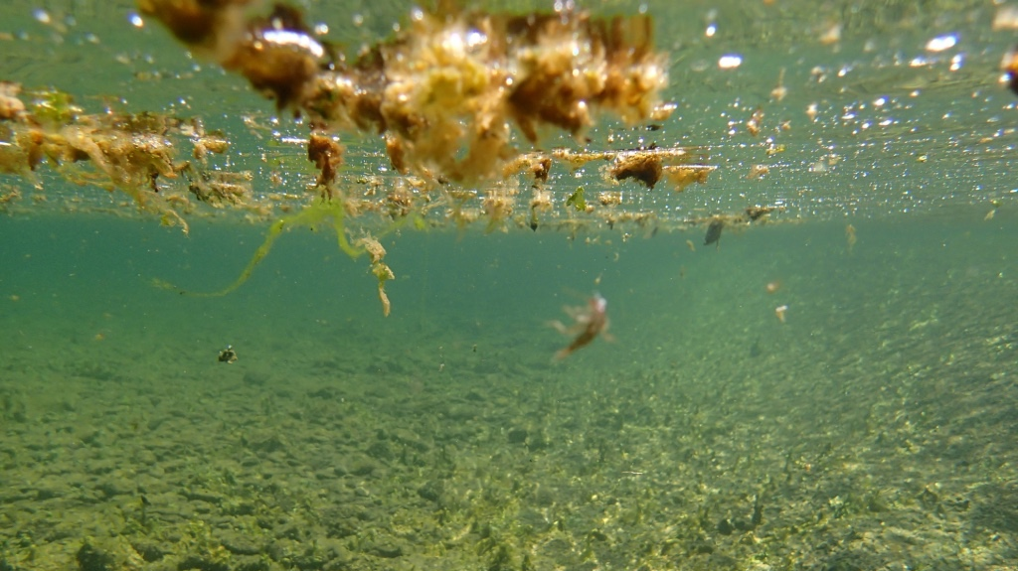
The future
Notes:
The past and present have improved our understanding of when and where HABs are occurring, and the species forming. We have gathered you all to discuss and shape the future of HABs management and policy in California.

Slide 8
FHAB Monitoring Strategy history
2016 Freshwater HABs Assessment and Support Strategy
2017 Conversations begin for a follow up strategy focused on research & monitoring
2018 Contract finalized
2019 January, work begins
2019 April, kickoff webinar
2020 March-June final products delivered
Notes:
2017 originally called a research strategy, realized that we needed more monitoring to guide the research, so the focus shifted
2018 delays in getting the contract in place and personnel changes at SCCWRP and the Waterboards

Slide 9
FHAB Monitoring Strategy objectives
Monitoring Strategy (Phase 1 current funding)
Develop ambient FHAB monitoring program
Management and Mitigation Strategy (Phase 2 future funding)
Recommendations/guidance for management and mitigation approaches
Research Strategy (Phase 3 future funding)
Determine priority areas of scientific research on all aspects of FHAB science
Notes:
The strategy will ultimately be 3 phases. Currently we are focusing on the monitoring, but there will be management and research strategies to follow. But currently these are not funded.

Slide 10
FHAB Monitoring Strategy objectives
Goal
Create a strategy and roadmap for how to implement ambient monitoring program for FHABs at multiple scales: statewide, regional, and single waterbody.
Two scales:
Single waterbody
Regional/statewide sampling
Notes:
The next step the state will take is to move beyond incident response and begin to plan for ambient monitoring of HABs in California.
2016 Document addressed ”Response to HAB events”
In 2019, address “Ambient Monitoring”
This strategy will address two scales. Regional/statewide monitoring and targeted single water body monitoring.

Slide 11
FHAB Monitoring Strategy objectives
Outputs
Monitoring framework
Framework for implementing ambient FHABs monitoring (statewide, regional, and individual waterbodies) to prioritize funding and program implementation
Audience: California environmental managers
Research special studies
Targeted studies to provide information to fill data gaps necessary to implement the FHAB Monitoring Strategy
Implementation guidance
Pragmatic guidance and recommendations to implement the methods described in the framework
Audience: Waterbody managers, regional staff, citizen science groups, tribes
Notes:
The strategy will produce three products.
First, a monitoring framework, which will be roadmap to implement a statewide monitoring program for HABs. This will be written for managers and help them understand the different funding needs for HABs monitoring and how to prioritize these funds. The framework will consider multi-tiered monitoring options and address the costs and data provided by different tools and methods to provide recommendations that best leverage the financial resources of the state.
Second, research special studies identify knowledge gaps that prevent the implementation of recommendations made in the framework or guidance documents. This document will be a list of potential questions and experimental or data collection designs that could answer the questions. About 3-5 of these will be developed into full proposals, so that if funding from the state became available, these projects would “shovel-ready.”
Third, implementation guidance: pragmatic how-to for managers and staff deciding to create a monitoring program for a region or waterbody. An individual should be able to read this document, in addition to pre-existing SOPs, and begin to build a monitoring plan for their water body.

Slide 12
Organizational Chart [and Role of TAC]
Project Manager and Primary Client
State Water Board (Office of Information Management and Analyses; OIMA)
Surface Water Ambient Monitoring Program
Provide feedback on proposed program, partners that can leverage existing monitoring or support new monitoring
Provides technical advice on design of FHAB monitoring program
Technical Advisory Committee
Stakeholder Advisory Committee
Technical Team
SCCWRP
Consultants; responsible for the “heavy lift”

Slide 13
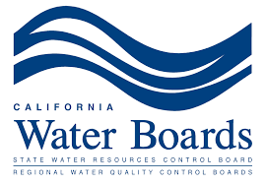
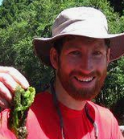
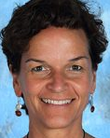
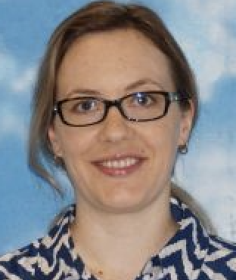
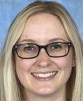
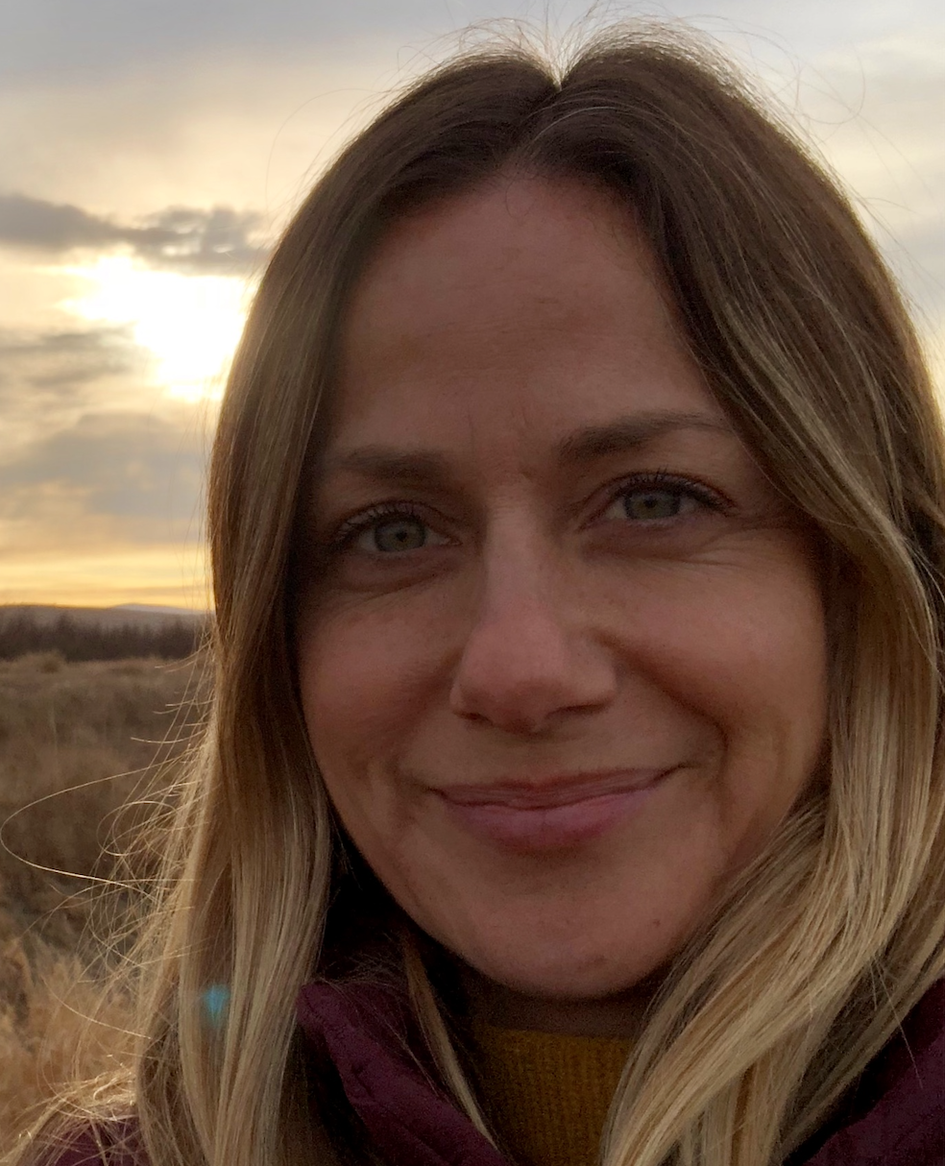
Introductions: Project Team
Keith Bouma-Gregson
Marisa Van Dyke
Ali Dunn
Martha Sutula
Jayme Smith

Slide 14
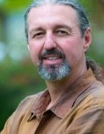
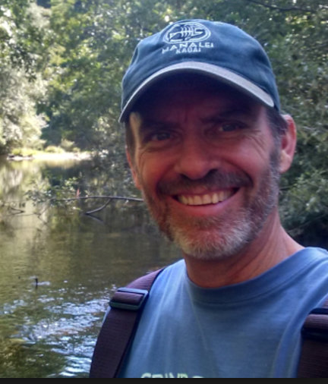
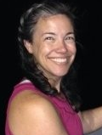
Introductions: TAC
Erik Burres
State Water Board
Tim Davis
Bowling Green University
Jennifer Graham
USGS
Raphe
Kudela
UC SC
David Caron
USC
Rich Fadness
R1 Water Board
Meredith Howard
R5 Water Board
Jennifer
Maucher
NOAA
Natalie Caulk
CA Coastkeepers
Alliance
Susan Fricke
Karuk Tribe
Christine Joab
R5 Water Board

Slide 15
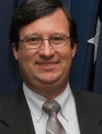
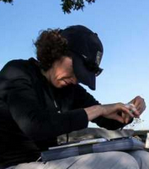
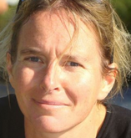
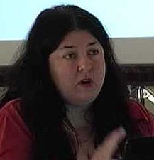
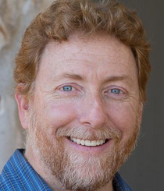
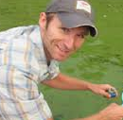
Introductions: TAC
Hans Paerl
UNC Chapel Hill
Beckye Stanton
CA Office of Env. Health Hazard Assessment
Steve Morton
NOAA
Susie Wood
Cawthron Institute
Carey Nagoda
San Diego
Water Board
Sarah Ryan
Big Valley
Band of Pomo Indians
Randy Turner
SFEI
Lori Webber
State Water Board
Joseph
Westhouse
State
Water Board
Tim Otten
Bend Genetics
Blake Schaeffer
US EPA

Slide 16
TAC teams
In Situ Survey Across Waterbodies
In Situ Waterbody Focused Monitoring
Remote Sensing Approach
Probabilistic sampling
Citizen Science
Satellites
Ambient surveys
Private/Public Waterbody Manager
Drones
Risk assessments
GIS
Regional Agency Staff

Slide 17
Stakeholder Advisory Group has overlap with TAC, but is meant to more broadly inform/outreach
CCHABs members
State Water Boards - TMDL, Standards, SWAMP, OEHHA
Regional Waterboards – SWAMP HAB Reps
US EPA
Water Resource Managers
Other state agencies that conduct monitoring or research studies on FHABs, such as DWR
Regional Park Districts (not State)
Lake managers (CALMS representatives)
Tribes (regional representatives, Klamath watershed, Clear Lake etc.)
Environmental Health officers (county health)
Citizen Science groups or other NGOs
HOA and private lake representatives
USGS California Water Science Center
CDPH (to inform non-water aspects such as fish, shellfish etc.)
Notes:
Advisory and guidance group, still recruiting to this group

Slide 18
Management questions
Themes: status, trends, risk, drivers, mitigation
Statewide and regional management questions
What is the overall extent and magnitude of FHABs in the Regions and the State?
To what extent are FHABs changing over time?
Which waterbodies are at risk to experience FHABs?
What are the drivers of FHABs?
How effective are water quality maintenance and improvement projects or programs for maintaining or restoring beneficial uses impacted from FHABs?
Notes:
These are core management questions that the TAC will use to guide their discussions. 2 scales, this slide is the statewide and regional scale
The questions address 5 themes, which are core to all SWAMP monitoring programs:
Status: current snapshot
Trends: changing over time
Risk: probabilistic models
Drivers
Mitigation
When finalized, the framework and guidance documents should be able to recommend methods to answer these questions.
Within each of these questions are many technical questions that need to be answered, such as: how do you define a bloom?, What are the modes of exposure to cyanotoxins at a particular waterbody? The TAC members will go through the process of identifying the information needed to answer these questions and how to collect that information given the tools available.

Slide 19
Management questions
Themes: status, trends, risk, drivers, mitigation
Individual waterbody management questions
Are FHABs degrading water quality in the waterbody?
What is the timing of FHABs in the waterbody?
Should active human use or domestic animal use be restricted in the waterbody?
When is it safe to resume active use?
What are the drivers of FHABs in the waterbody?
Notes:
The questions are slightly different at the regional and individual waterbody scale, but both sets of questions cover these 5 themes.

Slide 20
Waterbodies and beneficial uses
Beneficial uses are uses of water necessary for the survival and well being of humans, plants, and wildlife.
Core beneficial uses consolidates multiple uses and simplifies management context
F= Monitoring Framework, G= Implementation Guidance
Waterbodies | Core beneficial uses
 | Aquatic life | Swimmable | Fishable | Drinkable | Tribal Tradition and Culture
Wadeable streams | F, G | F, G | F, G | F | F
Non-wadeable streams | F, G | F, G | F, G | F | F
Lakes, reservoirs, ponds | F, G | F, G | F, G | F | F
Coastal confluences | F | F | F | F | F
Notes:
As many of you have probably already realized, answering these questions depends on the waterbody type and the way it is used by humans. This table identifies the types of waterbodies and beneficial uses to be considered by this strategy. The state of California has written it’s water quality standards around beneficial uses which are defined as, the uses of water necessary for the survival or well being of humans, plants and wildlife. These uses of water serve to promote the tangible and intangible economic, social and environmental goals of managers”
(San Diego Region Beneficial Uses summary: https://www.waterboards.ca.gov/rwqcb9/water_issues/programs/basin_plan/docs/update082812/Chpt_2_2012.pdf)
There are over a dozen beneficial uses officially recognized by the state, so to simplify things, SWAMP recognizes four core beneficial uses: aquatic life, swimmable, fishable, and drinkable. These are considered “umbrella” uses, in that by protecting for one of these “core uses” you are likely protecting for multiple other uses at the same time.
In addition to the four core uses, we are also explicitly adding “Tribal Tradition and Culture” to this strategy. Tribes can have different uses of water resources than other members of the public, and these uses may result in different modes of exposure to cyanobacteria and require additional considerations for effective HABs monitoring.
As for waterbodies, we are focusing on freshwater resources in the state. However, we are including “coastal confluences,” by this we mean estuaries and other freshwater-ocean mixing zones that may be receiving cyanobacterial biomass or cyanotoxins from upstream in the watershed. Or may be experience blooms in situ.
In the table, F designates a combination to be considered by the framework, and G represents a combination to be considered by the Implementation Guidance.
The implementation guidance will focus on a smaller subset of combinations that are of higher priority to SWAMPs mission statement. Our goal is that the creation of the framework will enable SWAMP to find more partners for HABs monitoring, such as drinking water agencies, coastal groups and citizen monitoring groups, so we can then collaborate on implementing the framework into these contexts.

Slide 21
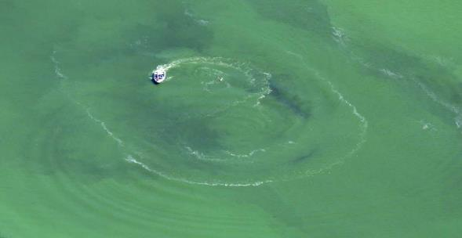
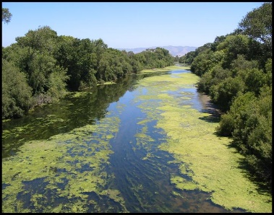
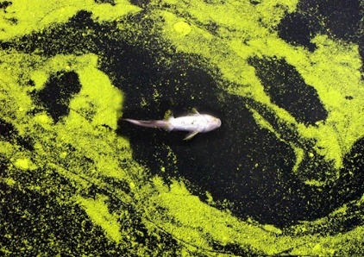
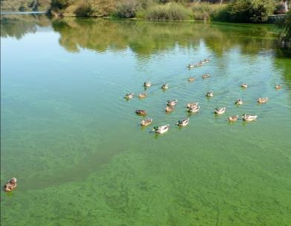
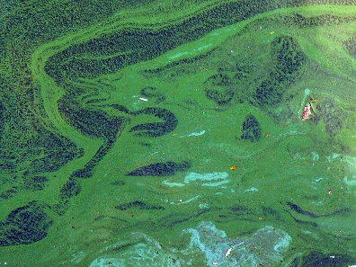
Thank you
Keith Bouma-Gregson and Marisa Van Dyke
Co-Leads Freshwater HABs Program
State Water Resources Control Board
keith.bouma-gregson@waterboards.ca.gov
marisa.vandyke@waterboards.ca.gov
Notes:
I hope you have a better idea of the history of HABs tracking and management in California. We have walked through the history and the goals and outputs of this strategy. We are very grateful to have this group assembled. We are excited at the potential to plan and prepare for an ambient monitoring program in California and hope it helps us better maintain and improve California’s water quality. Thank you all for being willing to contribute to California’s environmental protection.

