Slide 1
Green to Clean: Restoring Pinto Lake
Jackie McCloud
Senior Utilities Engineer
April 12, 2019

Slide 2
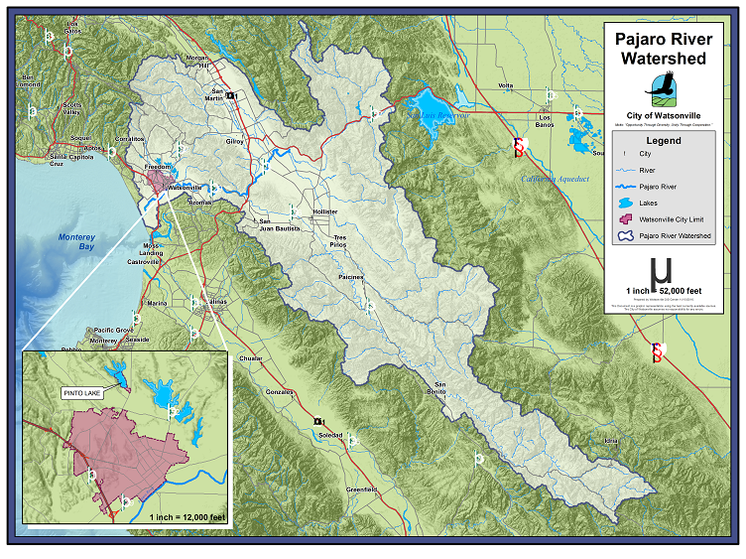
Notes:
State recognized economically disadvantaged community (approximately 66,000 residents)
Located in the 1300 sq mile Pajaro River Watershed (4 Counties)
Many types of land uses throughout Pajaro River Watershed
Pajaro River Nutrient TMDL adopted by EPA
Pinto Lake 303(d) listed waterbody, with a TMDL process in the works
Pinto Lake is a priority area → free recreational opportunities for residents
The goal of this project was based on the 2010 planning grant. To reduce nutrient loading’s in lake by 80% and reduce external loadings by 50%.

Slide 3
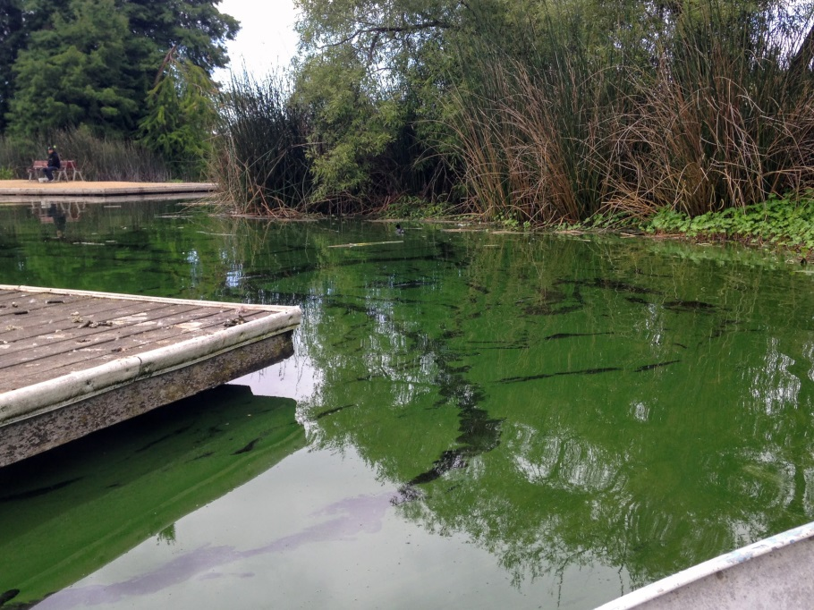
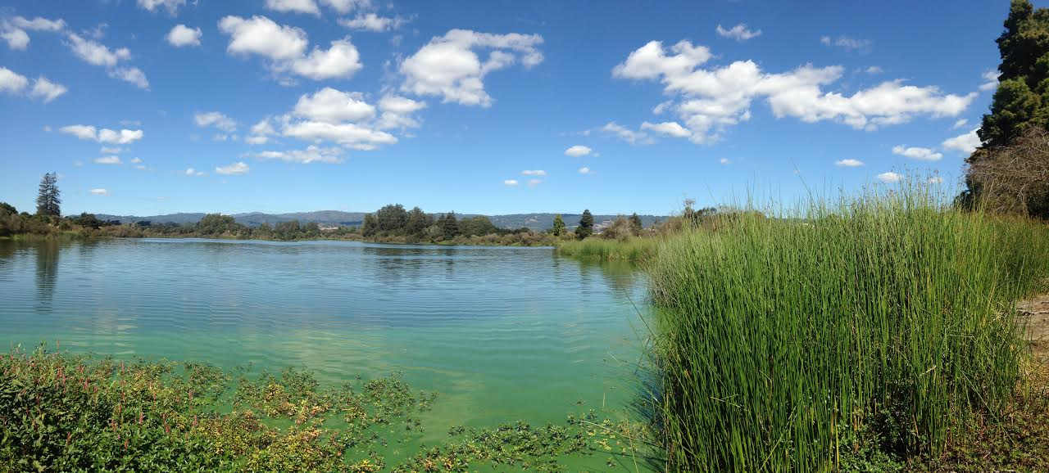
Pinto Lake
Massive cyanobacteria blooms occur in spring, summer and fall.
Predominantly aphanizomenon, dolicospermum and microcystis.
OEHHA and WHO Public Health Goal of 0.8ppb.
Multi agency effort to coordinate monitoring, notifications and solutions.
Notes:
Significant portion of nutrient loads are internal.
However, need to control external nutrient loadings from the watershed → installing best management practices in watershed, while partners continue to work with stakeholders in the watershed.
Pinto Lake TMDL and 303 (d) listing significantly aid in voluntary implementation and monitoring practices.

Slide 4
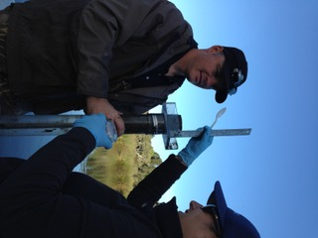
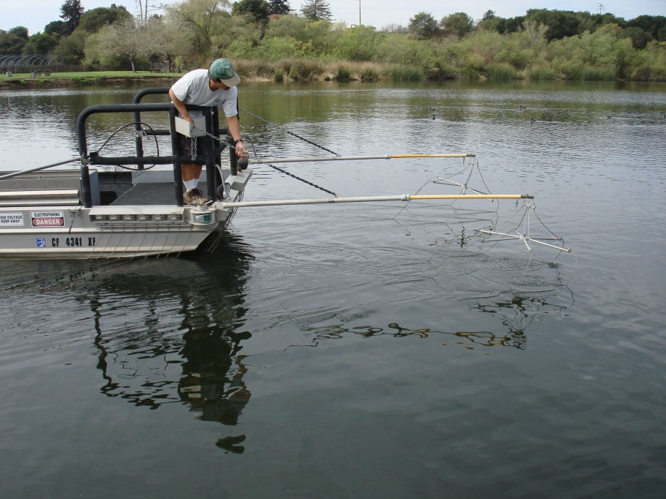
In-Lake Activities
Multiple management measures implemented:
Carp removal
Outreach and stakeholder involvement
Sediment Cores to determine amount of internal nutrient loading

Slide 5
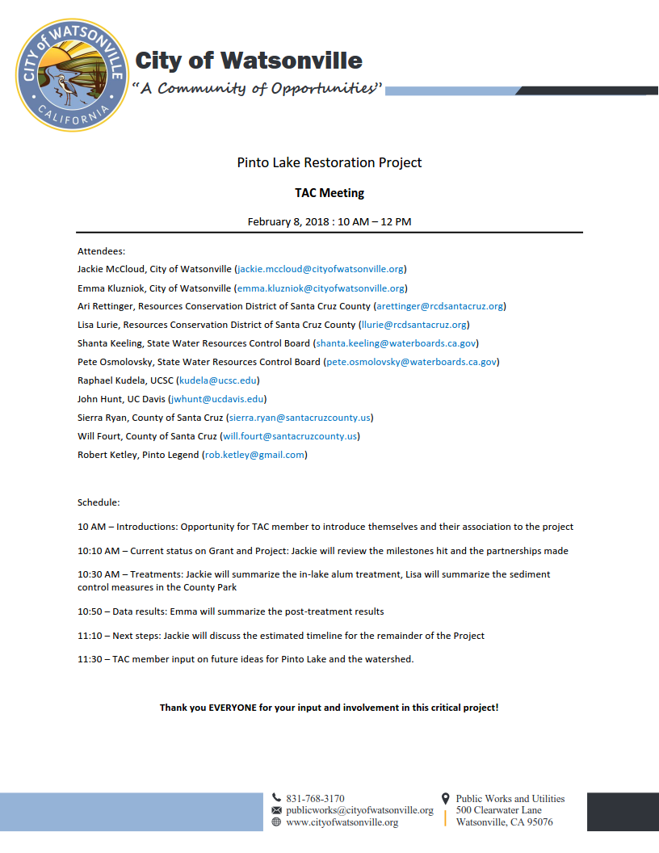
TAC Involvement
Notes:
In order to assess methodology and implementation, the City invited a range of experts to participate on a Technical Advisory Committee. This committee helped inform one of the first larger deviations from this project of alum injection in the tribs to holistic sediment control practices.
The TAC was called on upon at beginning of the project, before alum treatment and at the end of implementation to discuss future considerations for Pinto.

Slide 6
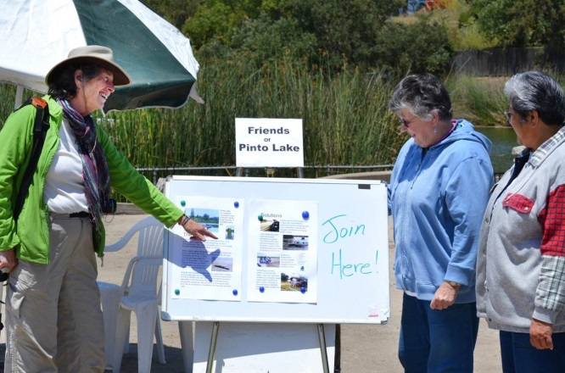
PARTNERS
Notes:
Project wouldn’t have been as successful with a lot of partnership and stakeholder involvement.

Slide 7
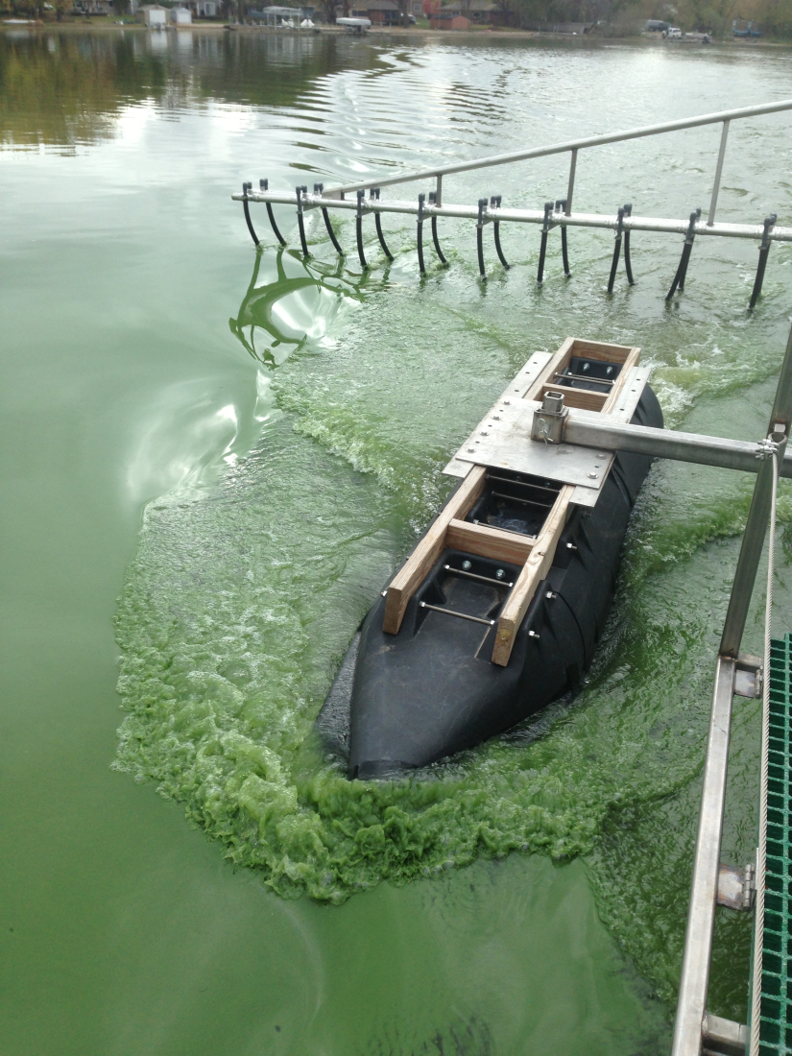
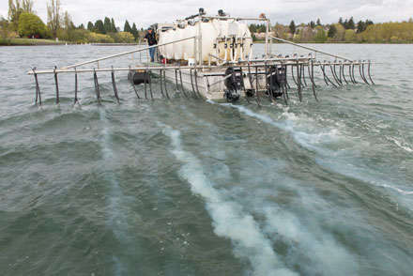
Alum Treatment April 2017
City staff researched:
Floating wetlands
Aeration
Alum treatment
Other types of chemical and biological treatment
Alum proved to be the best solution for Pinto
Lake
Notes:
Alum is a proven effective and safe technology. Permits were obtained through CDFW, Regional Board and Army Corps. The treatment took approximately 1 week to complete. The City did not need to close the lake, but we did need the public to steer clear of alum treatment operations.
After RFP process, City contracted with HAB Aquatics to perform work.

Slide 8
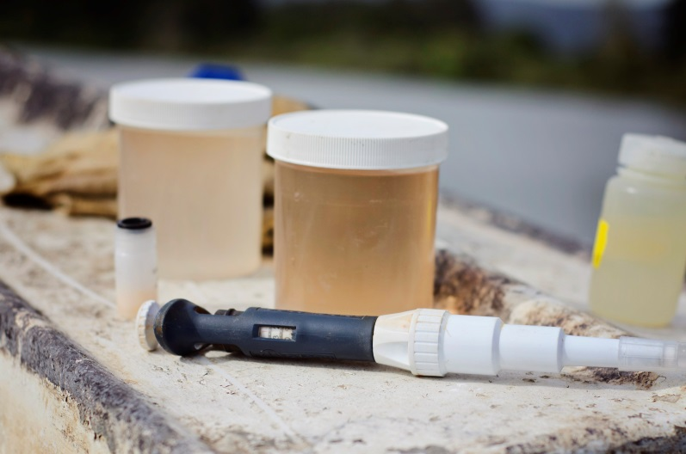
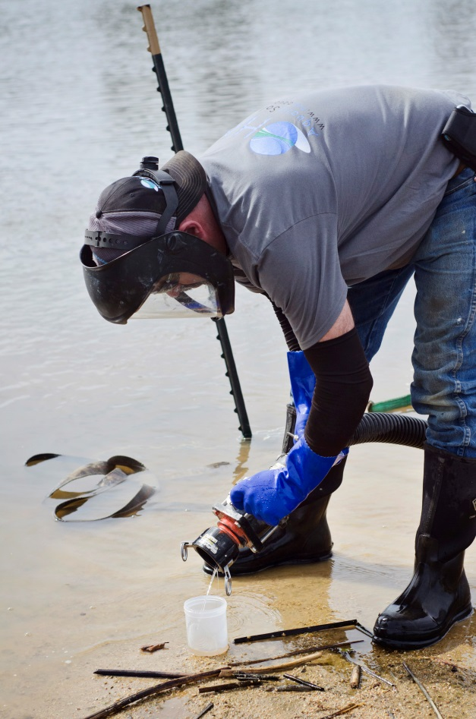
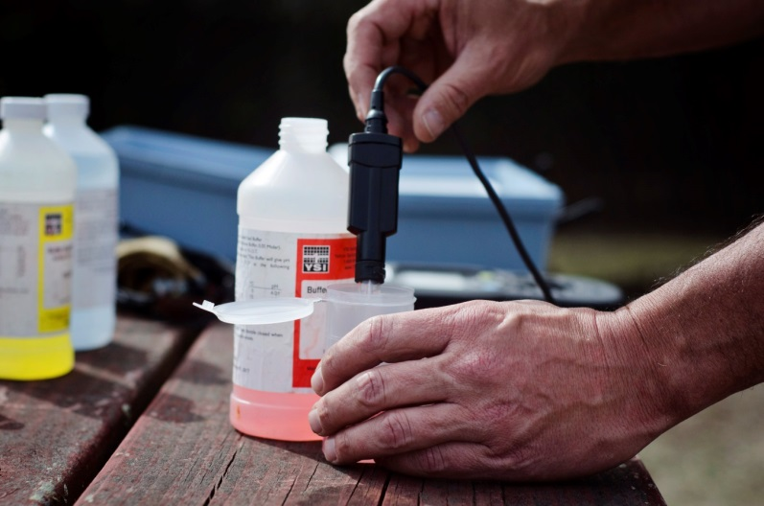
Water Quality Testing
Photos courtesy of Catherine Bosley, HAB Aquatics, LLC
Notes:
Dr. Holz took surface samples of Pinto Lake, pre alum application. He tested the pH and alkalinity of the water in order to determine dose rates and buffering capacity.
HAB continued to run analysis throughout entire treatment to make sure that there would be no environmental impact from treatment to the lake.
Dr. Kudela took one final SPATT sample pre alum application.

Slide 9
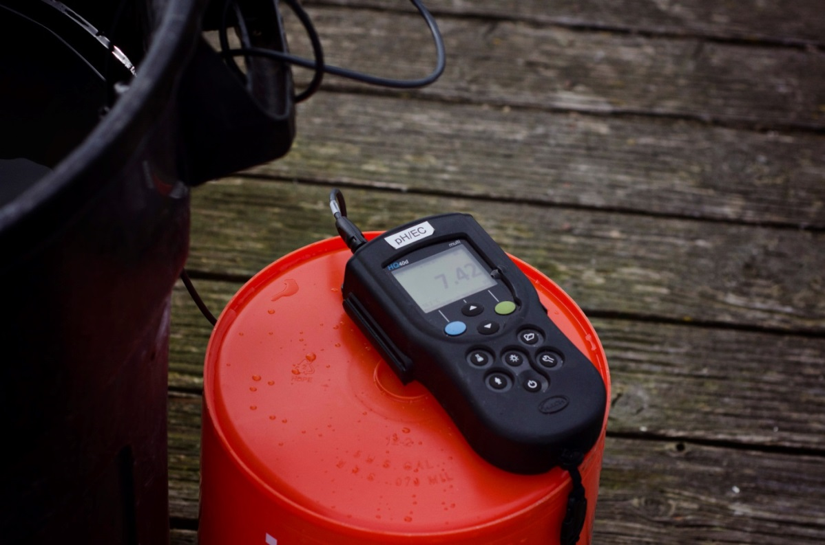
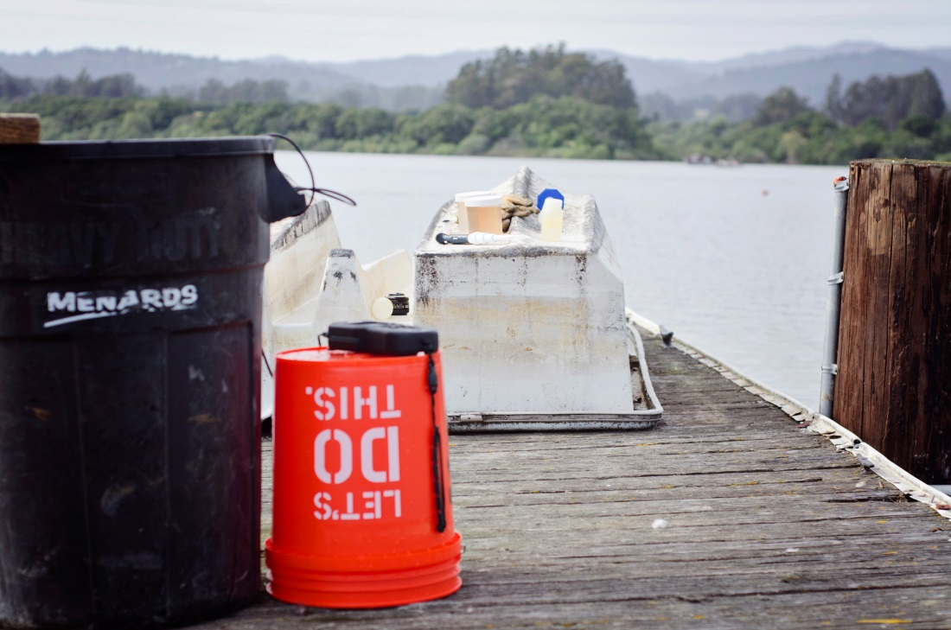
Pinto Lake
Jar Testing
Photos courtesy of Catherine Bosley, HAB Aquatics, LLC
Notes:
Additional water quality testing included performing a “jar test” for dosing calculations. Dr. Holz performed this analysis on site at Pinto Lake with every delivery of alum and sodium aluminate.

Slide 10
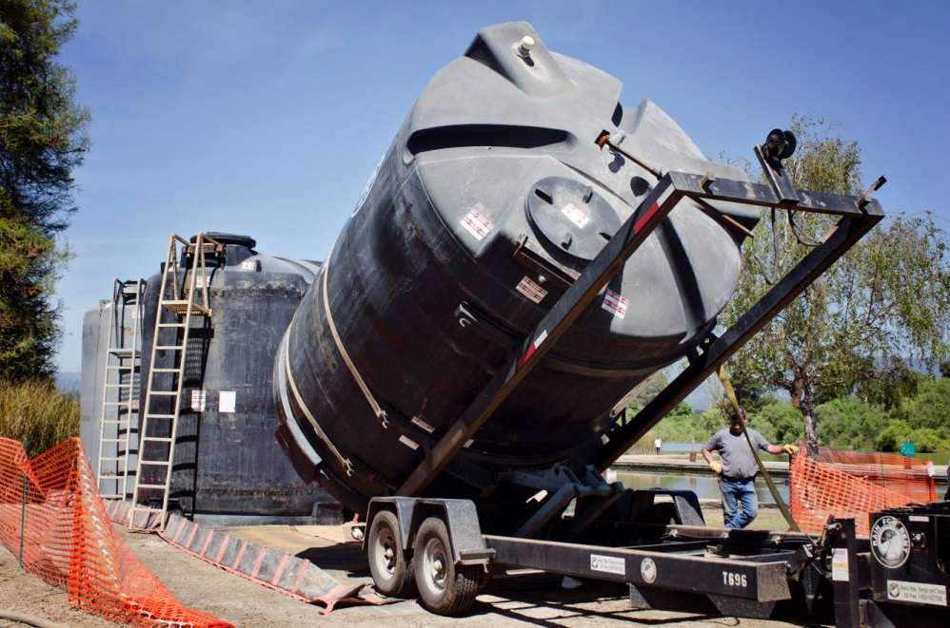
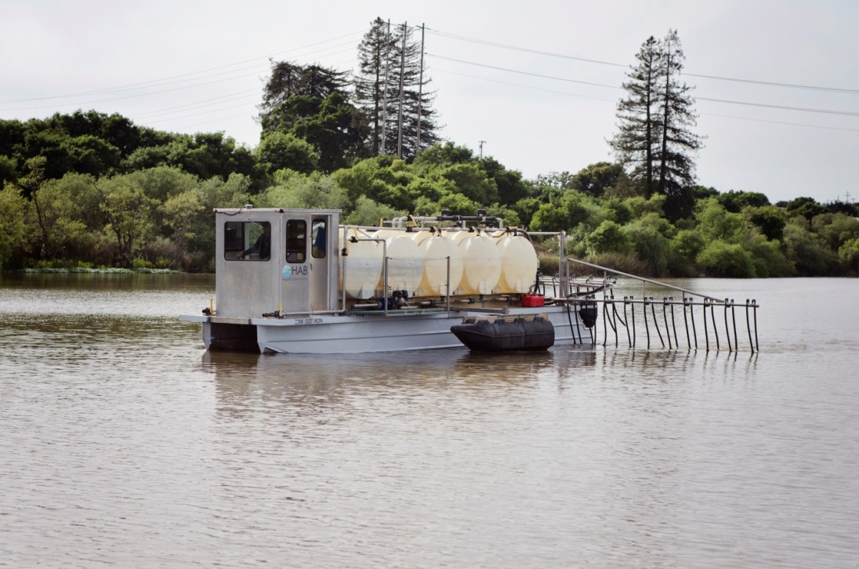
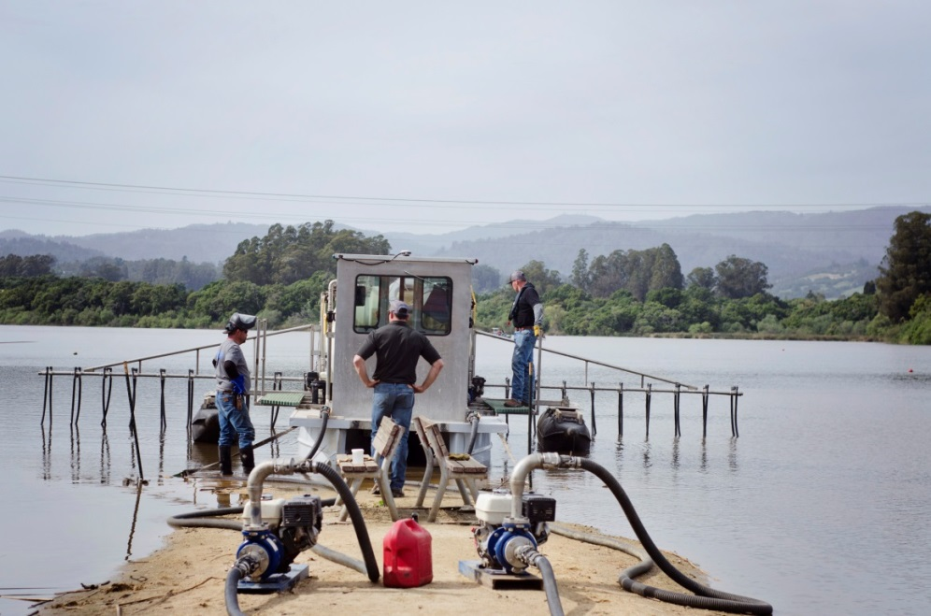
Photos courtesy of Catherine Bosley, HAB Aquatics, LLC
Notes:
Alum and liquid sodium aluminate was delivered multiple times during the day over the course of treatment. In order to reduce cost, tankers unloaded into storage tanks, with secondary containment, on shore. The alum/aluminate was then pumped from the tanks onto the barge. The barge continually treated Pinto Lake without any delays because of this system.

Slide 11
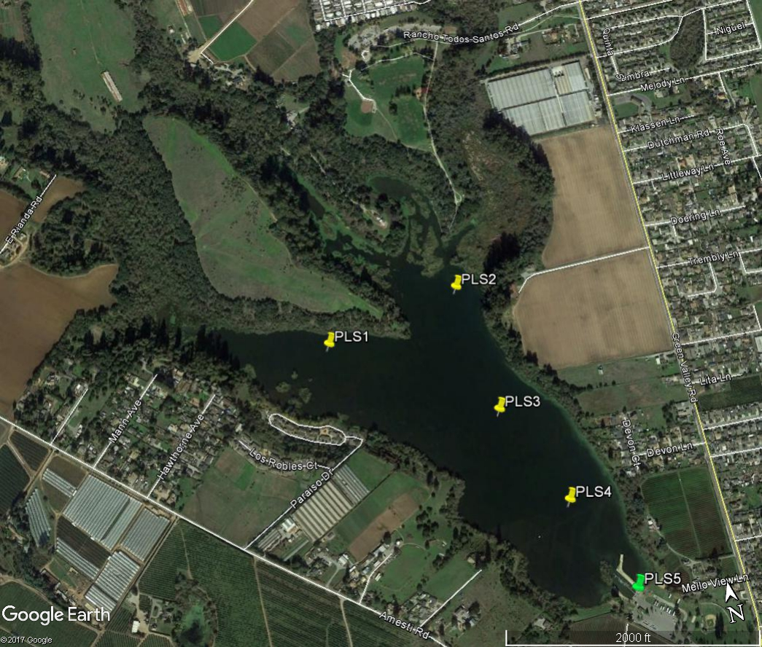
Sampling Points in the Lake
Notes:
5 sampling points in the lake – 1 at the City dock, 2 in the deepest parts of the lake, and 2 in the shallower reaches

Slide 12
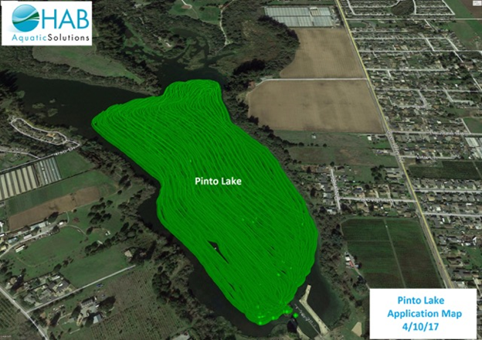
Alum Coverage
Notes:
Nearly 95% of lake treated with alum. 60% of total dose.
This was the printout from the on board GPS navigation on the alum barge.

Slide 13
Post-treatment Samples Confirm Successful Alum Treatment
Notes:
The average TP lake-wide percent reduction was 91%. This was calculated using the average of all of the results from the three pre-treatment sampling events (0.57 mg/L), and the average of all of the results from the three post-treatment sampling events (0.05 mg/L).

Slide 14
Post-treatment Samples Confirm Successful Alum Treatment
Notes:
The average orthophosphate (PO43-) lake-wide percent reduction was 98%. This was calculated using the average of all the results from the three pre-treatment sampling events (0.41 mg/L), and the average of all the results from the three post-treatment sampling events (0.01 mg/L). This reduction can be further illustrated by pointing out that 34 of the 36 post-treatment samples were below the reporting limit (of 0.02 mg/L).

Slide 15
Notes:
Following alum treatment, in April 2017, Pinto Lake didn’t experience as severe or as long a bloom as in pre-treatment Falls.

Slide 16
Microcystis Presents itself in Late Summer
Notes:
We have identified 21 species of algae in last year’s bloom
The first couple months’ make-up was dominated by aphanizomenon
The microcystis species started spiking 2 months in, and held through the completion of the bloom

Slide 17
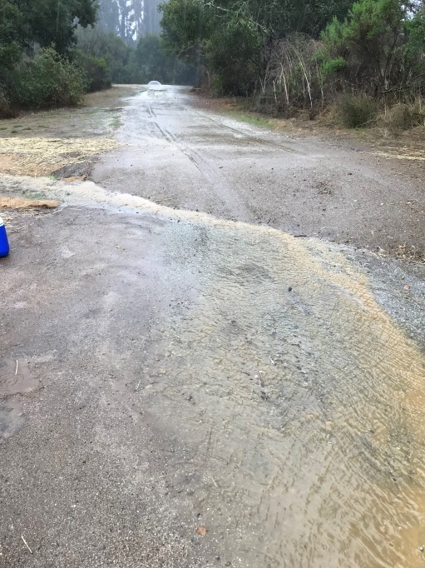
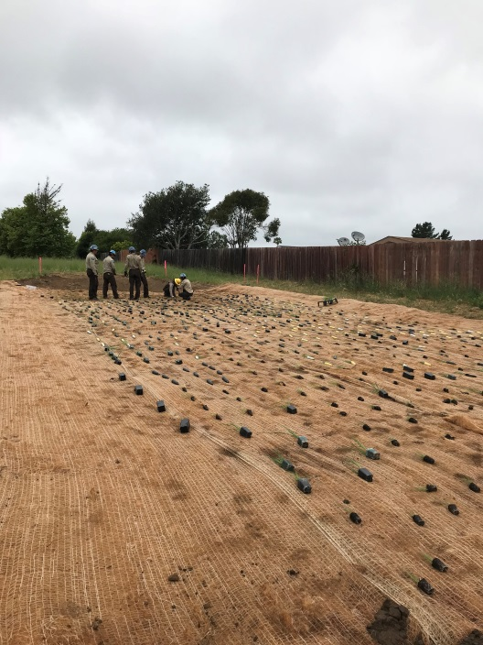
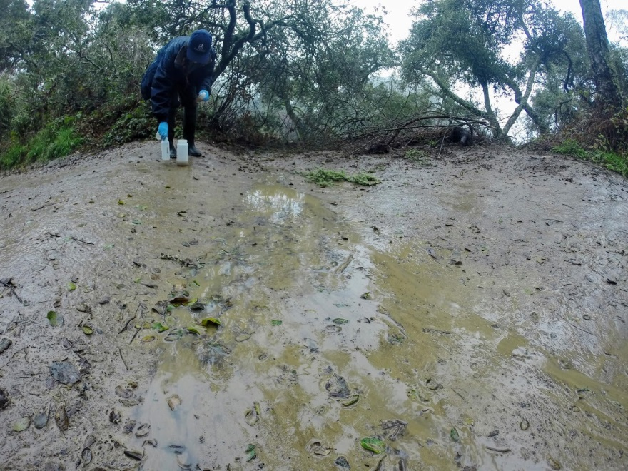
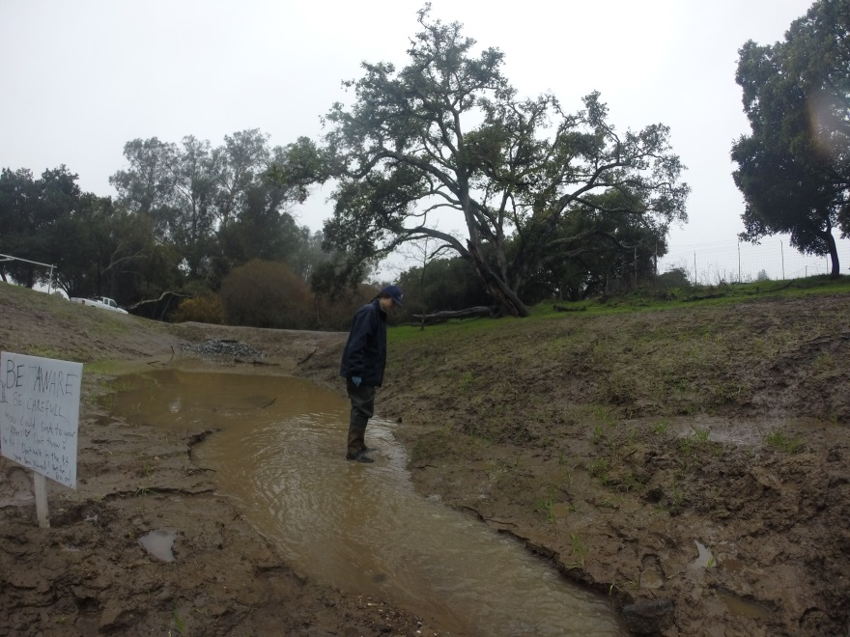
Watershed Activities
Targeted approach to improve Water Quality in: Amesti Creek, CCC Creek,
Todos Santos Creek
Rolling Dips

Slide 18
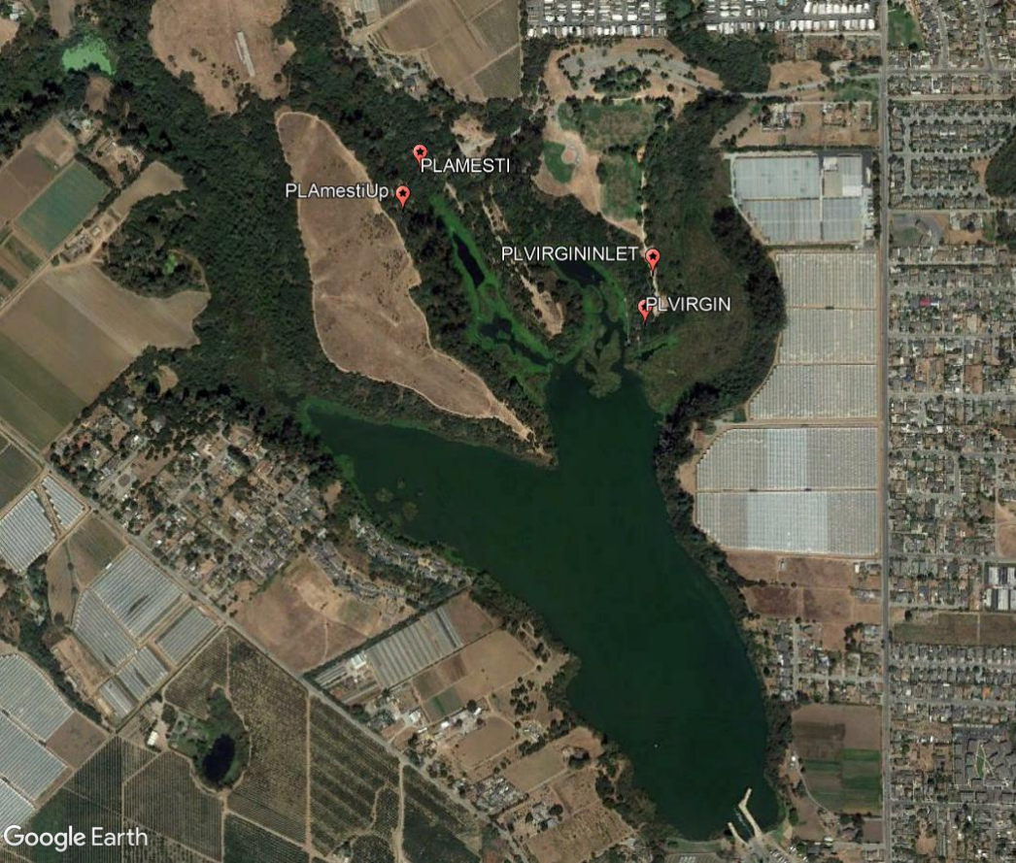
Sampling Points in the Watershed
Notes:
Established sampling points in the watershed, to monitor the success of the sediment control practices
At the practices we intended to measure upstream of the practice, and downstream of the practice

Slide 19
Less Sediment Measured in Amesti Creek, the Baseline Receiving Water
Notes:
3 pre events and 3 post events
An additional water quality benefit in Amesti Creek, the baseline receiving water, show a significant decrease of TSS (approximately 89%) concentrations after the implementation of the dips.

Slide 20
Less Phosphorus Measured in Amesti Creek
Notes:
3 pre events and 3 post events
Additional water quality benefit in Amesti Creek show significant decrease of TP (approximately 66%) concentrations after the implementation of the dips.

Slide 21
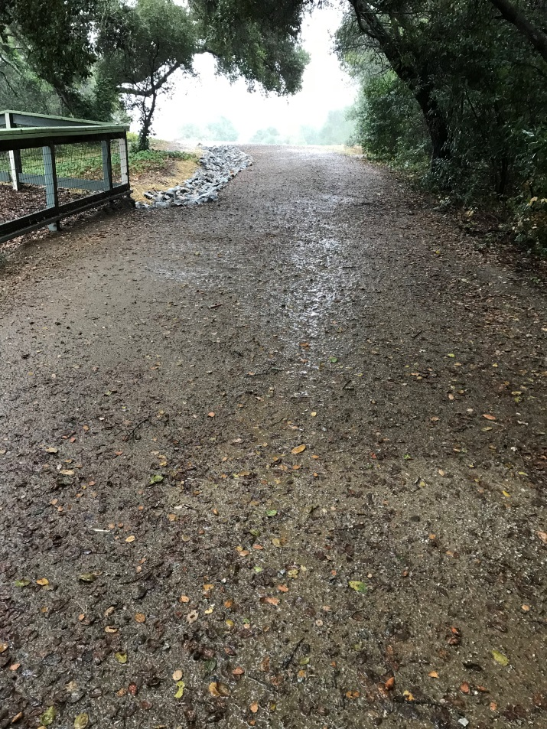
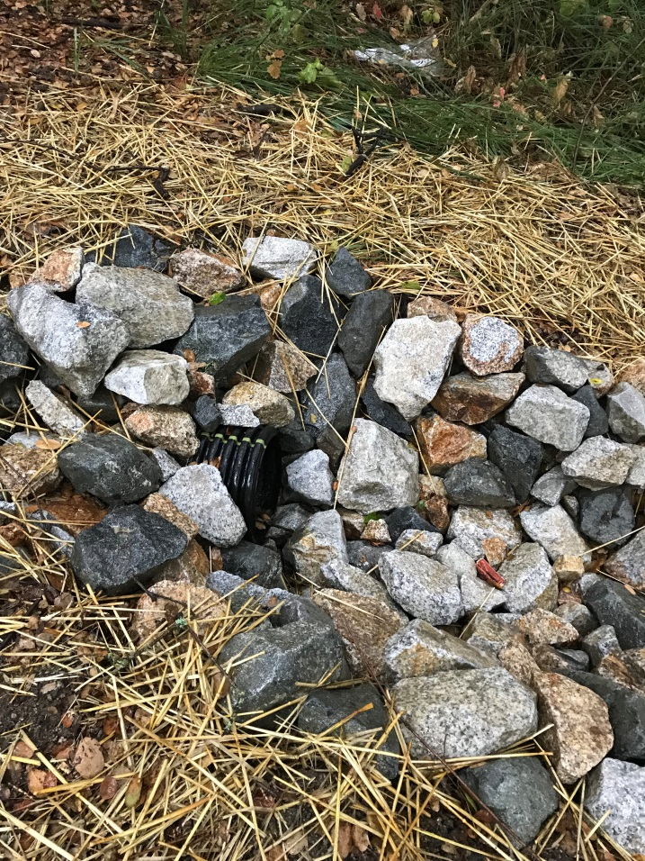
Sampling Points for the Virgin Mary Road Improvement Project
Upstream of the Virgin Rolling Dips (PLVIRGININLET)
December 8, 2016
Downstream of the Virgin Rolling Dips (PLVIRGIN)
December 8, 2016
The outlet, at the base of the Road
December 8, 2016
Notes:
Three post sampling events, measured upstream sediment (mg/L)
Couldn’t measure downstream sediment, because there was no flow, therefore no sediment was carried into PL
We also measured phosphorus and nitrogen, upstream, again no flow, no nutrients entered PL
The RCDSCC calculated that the dips resulted in an estimated sediment load reduction of 5.62 tons per year.

Slide 22
Notes:
As the Dips completely eliminated the runoff from the Virgin Mary Road into Pinto Lake, there was a 100% reduction of TP entering the Lake. These values represent the concentrations of phosphorus during three separate storm events, that did not enter the Lake.

Slide 23
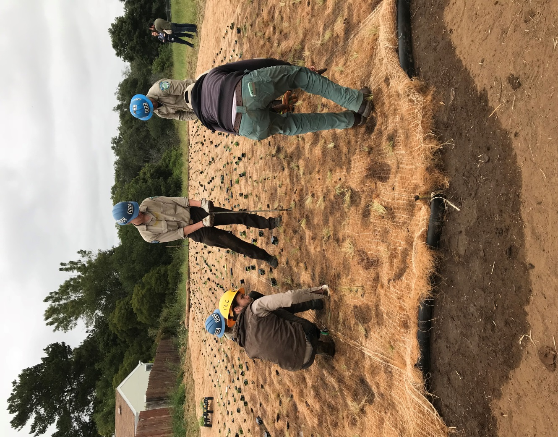
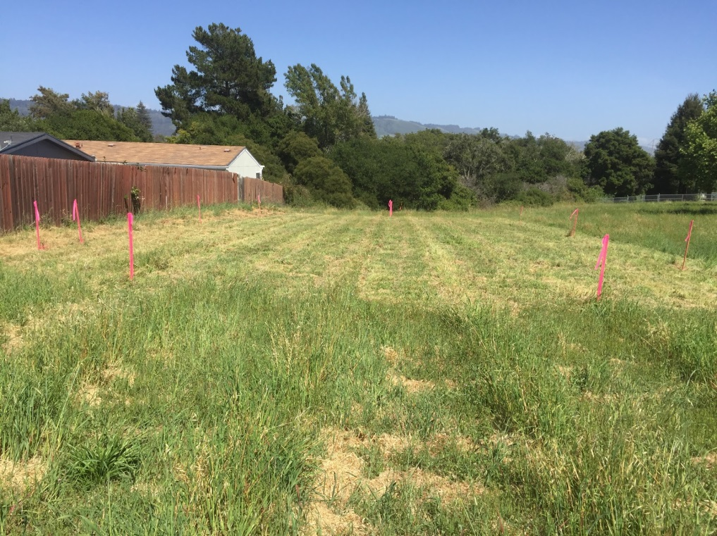
County Park Pump Track Filter Strip Project
Looking downstream towards the riparian area adjacent to Todos Santos Creek (trees seen in background of photo).
Before
During
Notes:
The County Park Pump Track Filter Strip Project is designed as a BMP to minimize potential pollutant loadings into the downstream Todos Santos Creek, a tributary to Pinto Lake.
Native perennial vegetation has been planted to slow the water, reduce the likelihood of erosion, and promote infiltration and bioreaction to reduce any potential pollutant loading into the downstream Todos Santos creek and Pinto Lake.

Slide 24
Estimated Reductions due to the County Park Pump Track Filter Strip Project
Before
After
Notes:
Due to the timing of implementation of the County Park Pump Track Filter Strip Project, which occurred after the 2017-18 winter rains, and directly prior to the end of the grant in June 2018, water quality monitoring was not possible. Instead the EPA Region 5 model was used to estimated load reductions:
Design reduction of 40% of the phosphorus load, per year.
Design reduction of 27% of the nitrogen load, per year.
Design reduction of 73% of the TSS load, per year.

Slide 25
Outreach and Education
“Slow it, spread it, sink it”
On farm practices
Residential
Septic
Notes:
Conducted 10 site assessments representing 305 acres,
Designed, permitted, and implemented 3 sediment management projects at priority sites, and assisted 4 growers with winter preparedness practices,
Conducted 6 stakeholder events to educate and engage the community on strategies to improve water quality in Pinto Lake, and
Reached out to over 5000 people to promote and educate community on nutrient management practices

Slide 26
Notes:
iSpy Science day was the final outreach event associated with the grant. This was held at the City park with multiple agencies represented.

Slide 27
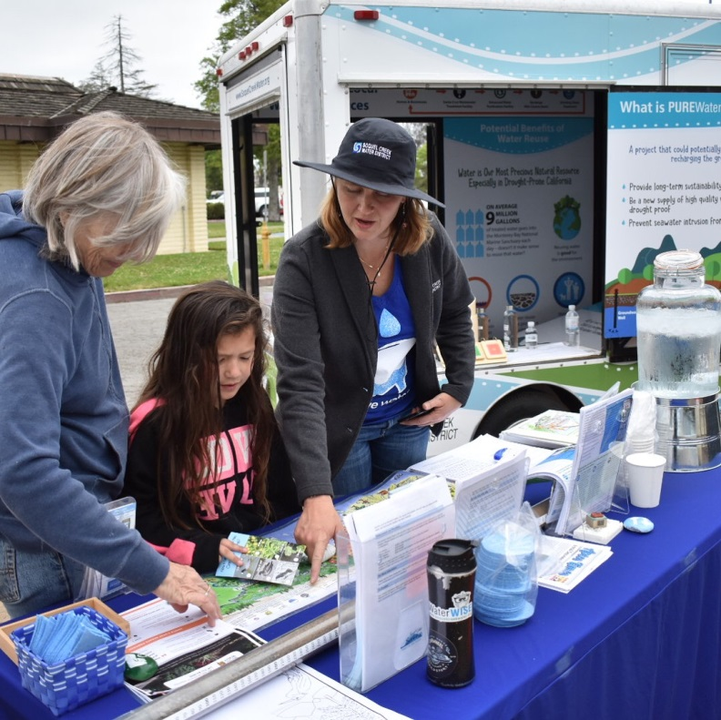
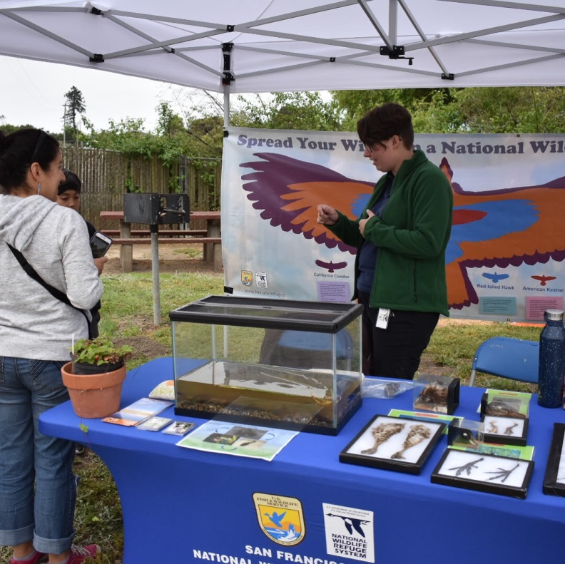
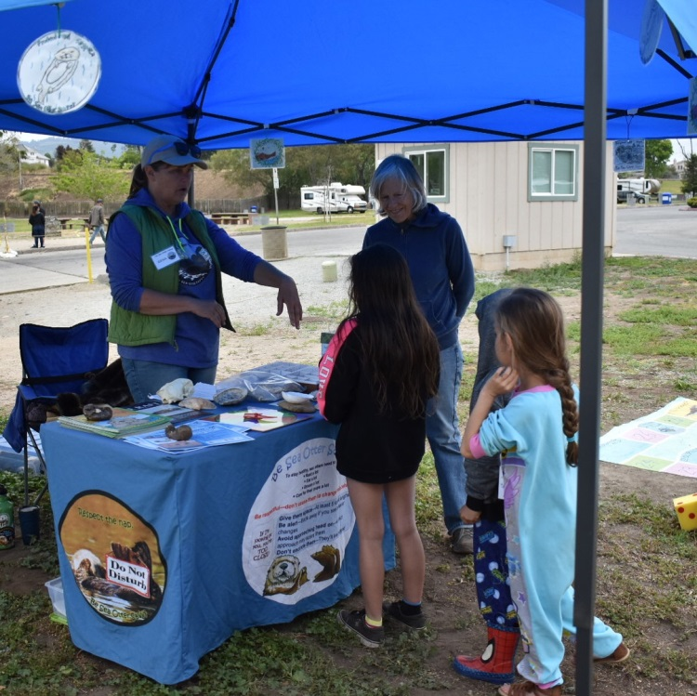
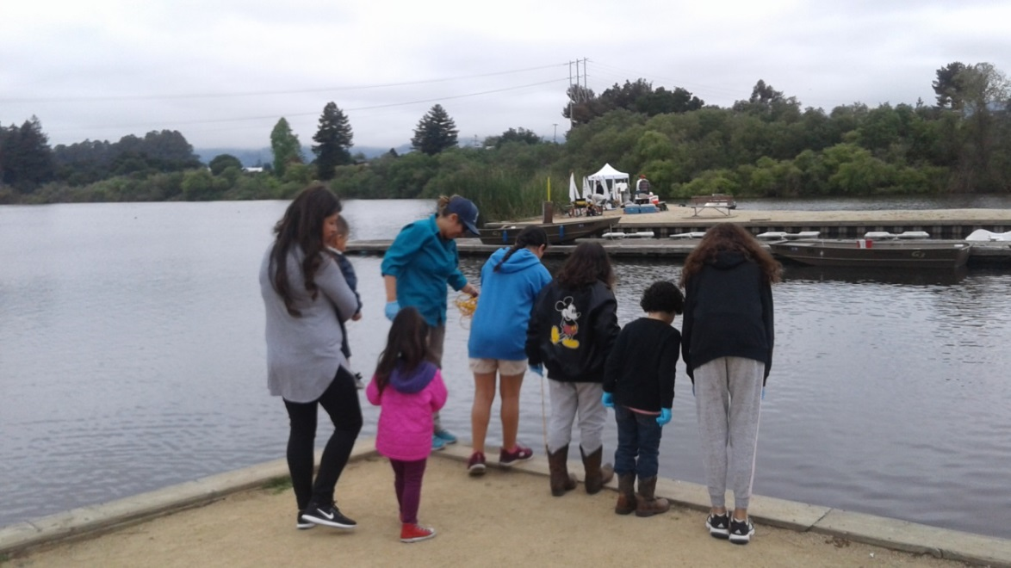
Photos courtesy of Angie Gruys, RCDSCC
Notes:
Pinto outreach day had 7 stations that community could visit and learn about water quality and habitat.
Had approximately 300 community members attend.

Slide 28
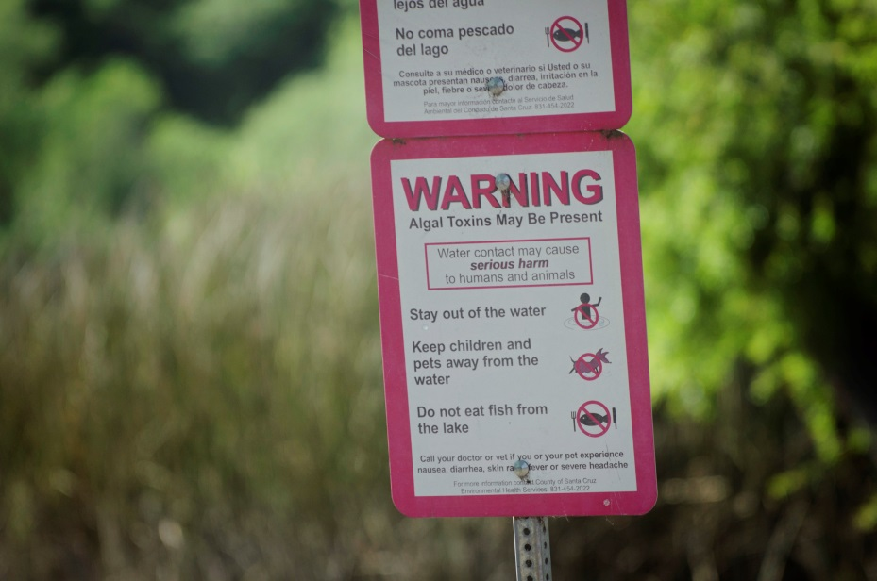
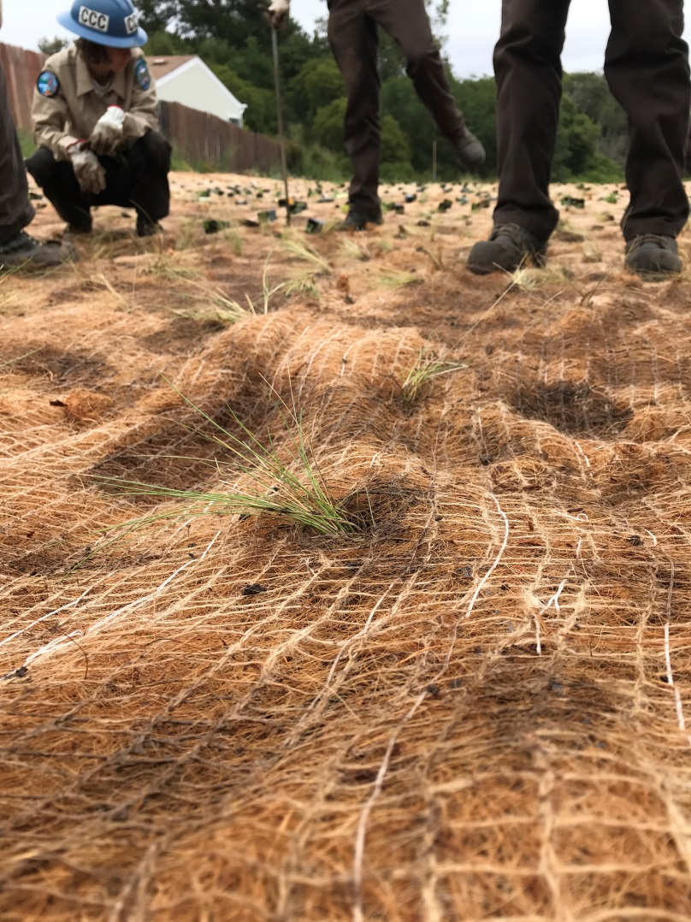
Next steps for Pinto Lake
Photo courtesy of Catherine Bosley, HAB Aquatics, LLC
Notes:
The City will continue to monitor cyanotoxins weekly.
Continue to work in the watershed to control sediments. Partner with local agencies to continue implementing projects, monitoring storm flows, shallow groundwater, and cyanotoxins.
The City would like to do an additional depth sampling in order to assess the longetivity of the alum.

Slide 29
Thank you for your time!
Photo courtesy of Catherine Bosley, HAB Aquatics, LLC
For additional information on the Pinto Lake Restoration Project:
Jackie McCloud
(831) 768-3172
jackie.mccloud@cityofwatsonville.org

