Slide 1
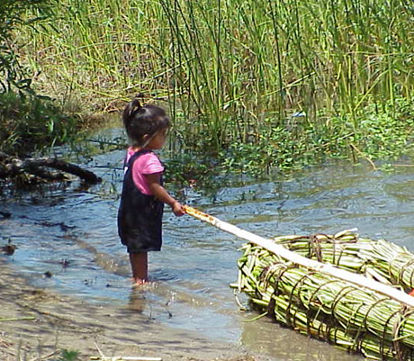
Tribes’ Water Programs in California -
Monitoring, Assessing and Protecting Water Throughout the State
Sarah Ryan, Environmental Director
Big Valley Band of Pomo Indians
January 18, 2019 CCHAB Network Presentation

Slide 2
California Native American Tribes
109 federally recognized in 34 counties in California
78 petitioning for recognition
Federal treaties from the 1860’s were signed but never ratified by Congress, leaving Tribes unprotected.
Some are now “landless” because of a series of policies that allowed the land to be sold from under them.

Slide 3
7 Language families with 83 known languages spoken

Slide 4
Tribal lands are located in some of the Waterboard regions; but there are Tribal interests in all of the regions.

Slide 5
Tribes are Self-Governed
The United States has a unique and distinctive political legal relationship with Native American tribal governments as set forth in the constitution, treaties, statutes, executive orders and court decisions. Since the formation of the Union, the United States recognizes Native American tribes as domestic dependent nations under its protection. The federal government has enacted numerous statutes and promulgated numerous regulations that establish and define a trust relationship with Native American tribes. Our nation has recognized the right of Native American tribes to self-govern. Native American tribes exercise inherent sovereign powers over their members and territory.
-https://tribalgovtaffairs.ca.gov/Laws_Regulations/

Slide 6
Tribal Water Monitoring Programs
Federally reviewed and approved Quality Assurance Program Plans
Annual Water quality assessment reports are required
56 Tribes in California have water quality monitoring data in the federal WQX (Water Quality Exchange) database.
Can be funded with a variety of sources including USEPA CWA 106, USEPA NPS 319, BIA Water Resources, BOR and other state or local sources.
Each funding source has its own requirements and restrictions about QAPPs, monitoring locations.

Slide 7
Tribal Water Monitoring Programs
In USEPA funded water monitoring programs, Tribes evaluate their data against existing uses to determine impairment in annual WQX (Water Quality Assessment Reports).
Tribes are piloting reporting impairments to ATTAINS (Assessment, Total Maximum Daily Load (TMDL) Tracking and Implementation System).
Tribes have site specific and time specific uses of water – more than ‘recreation’

Slide 8
Tribal Water Data
Exists in WQX, CEDEN and local databases
Is “final” or preliminary in WQX. Final is queryable by public
Tribes run the gamut of datalogger to project grab samples
Queryable data can be used in integrated reports and other regional or state evaluation efforts

Slide 9
Tribes as Water Quality Data Partners
Tribes are monitoring waterbodies throughout California to protect their uses and resources
Their data is legally defendable and available
Tribal programs should be partnered with to enhance cyanotoxin monitoring throughout the state

Slide 10
Sarah Ryan
sryan@big-valley.net
707-263-3924 x132

